Slide 1
Test Day Model - Update

Slide 2
Background
Currently calculate 305 day values for each lactation
305 day model uses one 305 day figure for Milk/Fat/Protein which summarises whole lactation
Operated on contract by CRV Holland – only evaluation not run in-house by ICBF.
Current model - trait is Heifer-Equivalent (calving @26 months)
Test day model – each parity (1-3) is a different (but correlated) genetic trait. Separate breeding value for each parity(1-3)

Slide 3
Actions – Test Day Model
Genetic parameters estimated 2012 milk/fat/prot incl additional Heterogenous Variance parameters
Submit initial HO/FR evaluation to interbull test run Jan 2013 Milk/Fat/Prot - passed Interbull test
Submit all breed (HO/FR, Je, NR/SR, Sim) evaluation to interbull test run Sept 2013 – passed Interbull test
Dec 2013 – test proofs generated incl genomics
  Milk/Prot proofs stack up well, Fat proofs stack up well overall – some queries
  Decision – not made official due to queries on fat

Slide 4
Actions
2014 re-estimate parameters, full re-work of model
Submit milk/fat/prot to Interbull test run Sep 2014
Results – passed Interbull test
Decision – not to proceed

Slide 5
Actions
Specific evaluation by CRV excluding HV correction
Apr 2017 - Timo Pitkänen (LUKE) visit ICBF 4 months
Complete analysis of model
Results presented here (basically same as previous presented but with 2 years more data)
Plan submit Interbull Test run Sep 2017
Implement at suitable time afterwards

Slide 6
Data
Individual test day records (i.e. raw milk recording)
Tests since 1/1/1996
Animals with known sire/dam
All parities up to 15
PARITY | Records | Cows | PARITY | Records | Cows
1 | 7,524,368 | 1,517,884 | 9 | 327,470 | 70,960
2 | 6,199,088 | 1,231,431 | 10 | 158,772 | 35,176
3 | 4,845,157 | 964,849 | 11 | 70,574 | 15,966
4 | 3,655,977 | 734,590 | 12 | 29,370 | 6,780
5 | 2,591,464 | 526,347 | 13 | 10,904 | 2,581
6 | 1,728,348 | 355,871 | 14 | 3,825 | 945
7 | 1,070,985 | 223,290 | 15 | 1,590 | 356
8 | 614,545 | 130,847

Slide 7
Weighing by Parity
Records from last 6 years
Other Countries
Nordic Countries
  50 : 30 : 20
Holland
  41 : 33 : 26
  https://www.crv4all-international.com/wp-content/uploads/2016/03/E-7-milk-production.pdf
PARITY | Num Records | Fraction | Weighting
1 | 970,737 | 1 | 41%
2 | 781,567 | 0.81 | 33%
3 | 611,521 | 0.63 | 26%
4 | 468,900 | 0.48 | 20%
5 | 339,935 | 0.35 | 14%
6 | 233,054 | 0.24 | 10%
7 | 148,637 | 0.15 | 6%
8 | 88,362 | 0.09 | 4%
9 | 48,495 | 0.05 | 2%
10 | 24,413 | 0.03 | 1%
11 | 11,519 | 0.01 | 0%
12 | 5,072 | 0.01 | 0%
13 | 1,952 | 0.00 | 0%
14 | 710 | 0.00 | 0%
15 | 189 | 0 | 0%
Base cow is unchanged
(born 2005, calved 2007)

Slide 8
Correlations between old/new proofs
 | Num Anis | Milk | Fat | Prot
Bulls >90% | 2258 | 0.966 | 0.970 | 0.956
Bulls >70% | 3557 | 0.954 | 0.947 | 0.939
All Cows with records | 1831295 | 0.924 | 0.935 | 0.923
Alive Cows with records | 626774 | 0.956 | 0.958 | 0.953

Slide 9
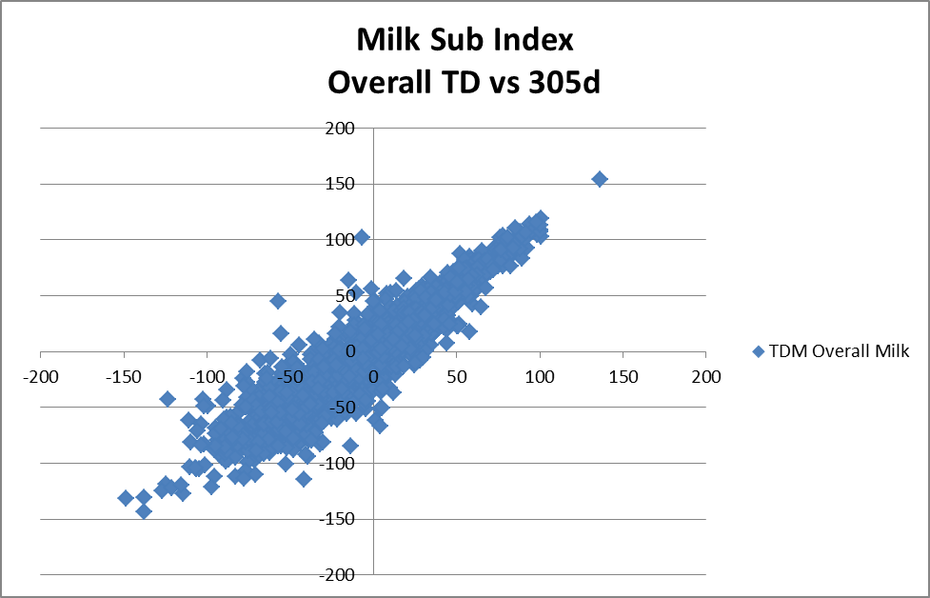
Old vs New – Ai Bulls
Milk Sub Index

Slide 10
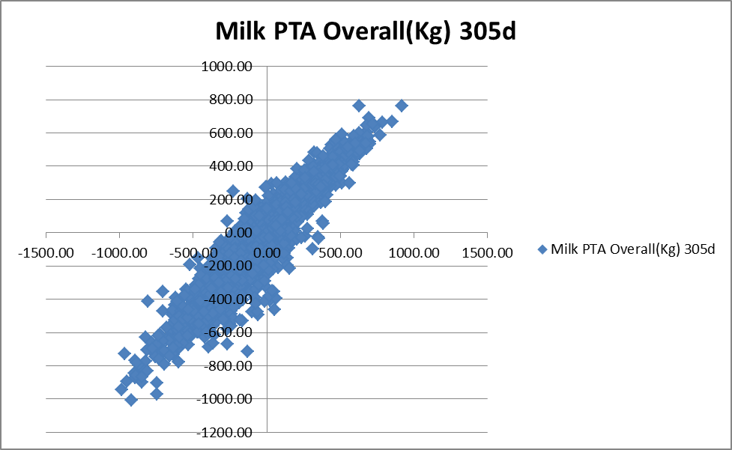
Old vs New – Ai Bulls
Milk PTA(Overall)

Slide 11
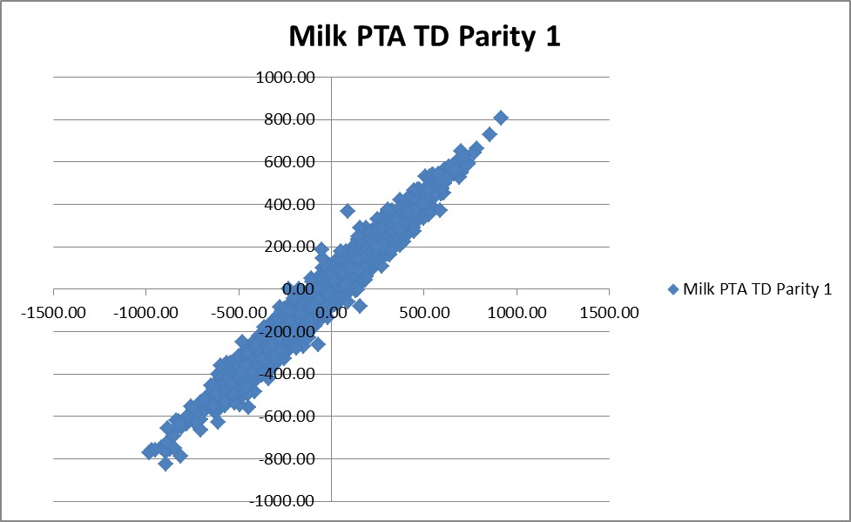
Old vs New – Ai Bulls
Milk (Parity 1)
  Note tighter correlation with parity 1 PTA, as current model is Heifer Equivalent

Slide 12
Reliability Changes
 |  | Milk Rel
 | Num Anis | 305d | Td
Cows with records | 1,831,295 | 58.6 | 67.7
Alive Cows with records | 602,218 | 57.2 | 65.3

Slide 13
Changes different Animals
 |  | Milk |  | Fat |  | Prot
 | Num Anis | Td | 305 | Td | 305 | Td | 305 | Milk SI Euro Difference
Active AI Bulls | 530 | 44.73 | -2.04 | 5.52 | 4.44 | 4.20 | 2.57 | 7.72
Bulls >50% | 4246 | -2.56 | -25.56 | 0.54 | 0.17 | -0.35 | -0.83 | 1.54
Bulls >70% | 3557 | 14.82 | -4.16 | 1.37 | 1.17 | 0.39 | -0.01 | 1.13
Bulls >90% | 2258 | 36.38 | 17.22 | 2.31 | 2.15 | 1.39 | 0.95 | 1.41
All Cows | 1831295 | -2.47 | -13.21 | 0.58 | 0.55 | 0.06 | -0.07 | 0.06
All Cows alive | 626774 | 42.39 | 1.96 | 2.95 | 3.04 | 2.87 | 1.61 | 5.62

Slide 14
Changes different Breeds
Milk |  | Fat |  | Prot
Avg Td | Avg 305d | Avg Td | Avg 305d | Avg Td | Avg 305d | Milk SI Euro diff | Num Bulls | Avg Age | Breed
122.44 | 102.41 | 3.82 | 3.59 | 3.37 | 2.86 | 3.37 | 1638 | 22/05/1997 | HO
-165.87 | -200.28 | -2.79 | -3.35 | -3.72 | -4.81 | 5.12 | 238 | 18/12/2000 | FR
-305.77 | -356.50 | 12.71 | 11.71 | 0.67 | -0.44 | 5.64 | 104 | 30/07/2005 | JE
-126.15 | -103.31 | -7.87 | -5.82 | -3.57 | -2.84 | -4.21 | 58 | 24/12/1994 | MO
-157.05 | -191.26 | -2.76 | -3.53 | -1.38 | -2.70 | 8.28 | 33 | 07/08/1999 | NR
-296.64 | -323.57 | -8.39 | -8.59 | -5.54 | -6.66 | 4.53 | 28 | 22/06/1997 | MY
-121.50 | -168.69 | 0.13 | -1.50 | -1.67 | -3.31 | 8.34 | 8 | 18/01/1997 | SR
  Bulls >=87.5% of the breed

